Slide 1
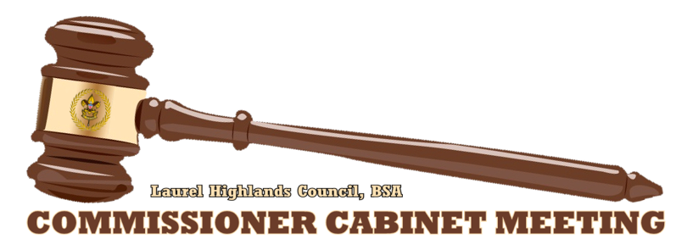
December 16, 2014

Slide 2
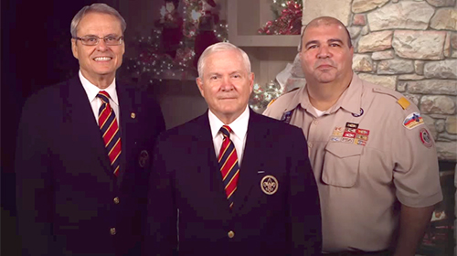
Happy Holidays
“Scouting happened because of dedicated volunteers and staff.”
“We want to take this moment to say thanks for what you did (for Scouts).”
“We look forward to working shoulder to shoulder with you again next year.”
Wayne Brock
Bob Gates
Tico Perez

Slide 3
COMMISSIONER Training Updates
Jack Boyde
Assistant Council Commissioner – Training & Recognition

Slide 4
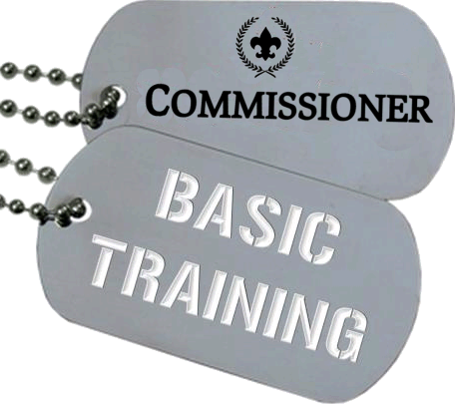
COMMISSIONER Training Updates
February 14 – Area 2 8:30 AM – BC3 Cranberry, PA

Slide 5
COMMISSIONER Training Updates
2015 SCHEDULE
February 14 – Area 2 8:30 AM – BC3 Cranberry, PA
April 11 – Area 6 & 7
June 6 – Area 3
October 10 – Area 1
December 12 – Area 4

Slide 6
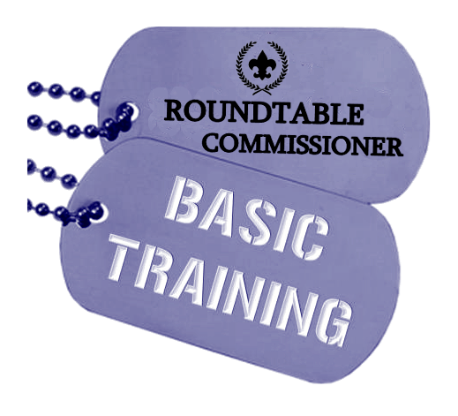
COMMISSIONER Training Updates
February 14 8:30 AM – BC3 Cranberry, PA

Slide 7
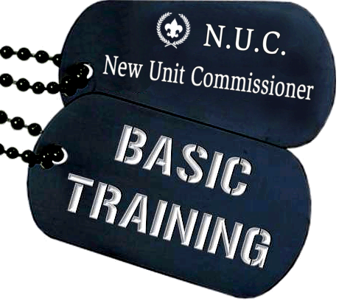
COMMISSIONER Training Updates
April 11 – Location TBD

Slide 8
COMMISSIONER Training Updates
March 14, 2015

Slide 9
Commissioner Conference
June 14 Camp Guyasuta

Slide 10
COMMISSIONER General Updates

Slide 11
#1 Priority
Just a test…
Notes:
3 New Commissioners in Mingo Trails!

Slide 12
Charter Renewal
(Status report)

Slide 13
Looking Ahead
Save-A-Scout!!!!
Set Dates
Recruit Team
Plan to Succeed
13

Slide 14
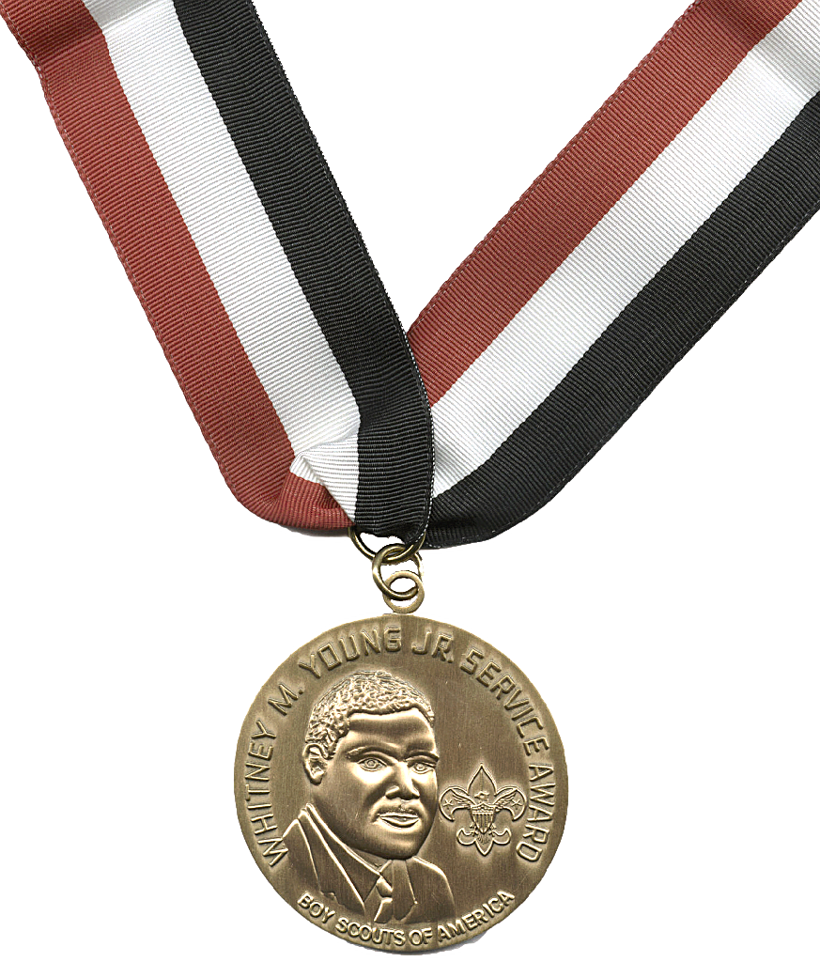
Looking Ahead
Whitney M. Young, Jr. Award Dinner
February 19, 2015
Vern Smith – 2015 Awardee
14

Slide 15
Career Enhancement
The Council Commissioner should have a “vision” that includes four things.
How a good unit program helps youth stay in the program long enough to learn Scouting values.
Exceptional unit service that exceeds unit leader expectations.
Districts with a no-lapsed units/no-dropped units commitment.
Complete staff in every district.
#14-160 Selecting A Council Commissioner

